Slide 1
Skies
By

Slide 2
research
Include relevant sky images of the following:
Time lapse
Time splice
Multiple images overlapped

Slide 3
Sky photoshoot

Slide 4
Sky photoshoot

Slide 5
Best photo full size

Slide 6
Best photo full size

Slide 7
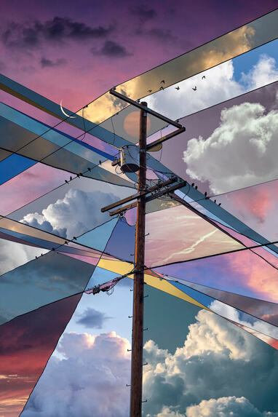
Working in the style of Alex Hyner – Twenty skies
To create this image I…
Something I like about it is…
I could develop further it to be more individual by…

Slide 8
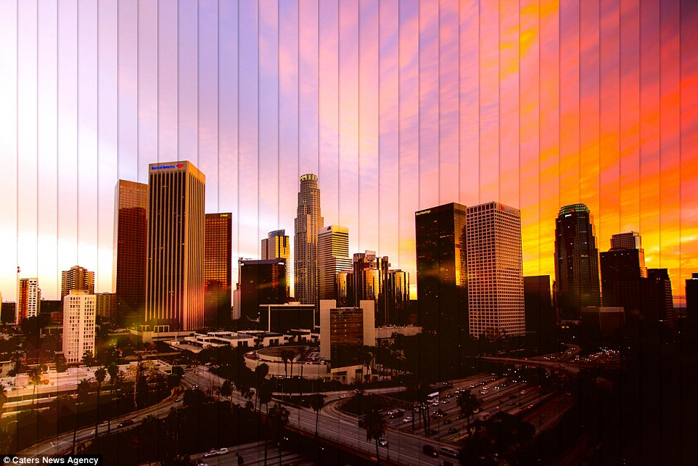
Working in the style of Daniel Marker Moore – Time Splice
To create this image I…
Something I like about it is…
I could develop further it to be more individual by…

Slide 9
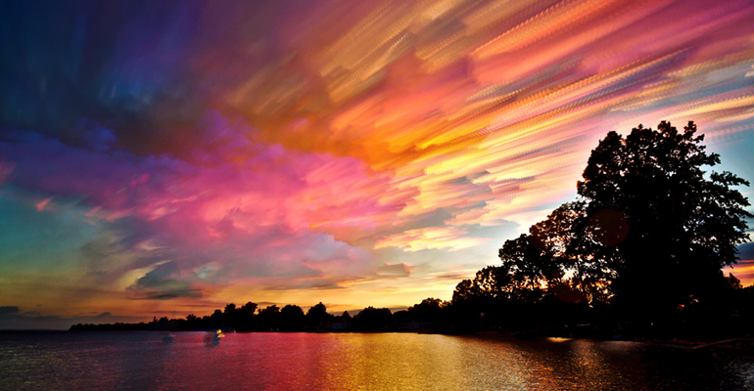
Working in the style of Mark Molloy – Time lapse effect
To create this image I…
Something I like about it is…
I could develop further it to be more individual by…

Slide 10
experiments

Slide 11
experiments

Slide 12
experiments

Slide 13
Outcomes

Slide 14
evaluation
Through this mini project I have learnt to…
I refined my ideas through experiments with…
My outcomes linked mostly to …artist… by…
Something that I feel was successful was…
With more time I would continue to develop…

