Slide 1
Notes to help:
For the higher marks, you need to demonstrate a really good understanding of the artist's work and techniques, and make thoughtful comments about how you could take inspiration from their work, thinking about how you could be individual rather just copying.
Key words:
Colour, composition, pattern, shape, line, leading lines texture, negative space, balance, rule of thirds, symmetry, Layering, overlap, blur, opacity, contrast, abstract, unusual, change, alter, realistic, unrealistic, futuristic, architecture, building, skyscraper, tower block, town, city, surroundings

Slide 2
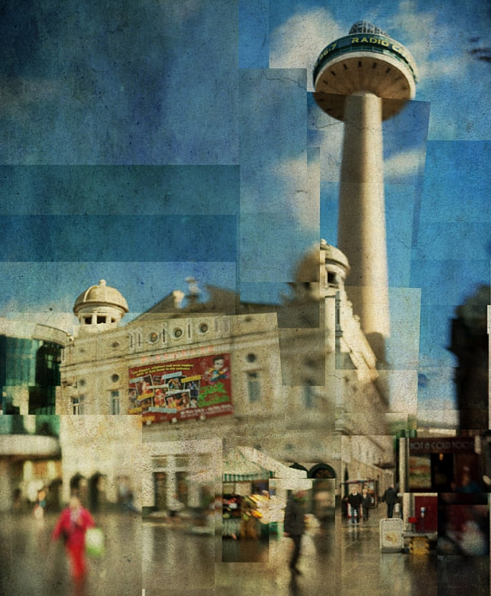
Stephen McNally - Photocubism
Artist's Name takes photographs of... He/she takes his/her photos by... This photographer considers formal elements in their work by... Something I like about Artist's Name's photography style is... I could take inspiration from this photographer in my own work by...

Slide 3
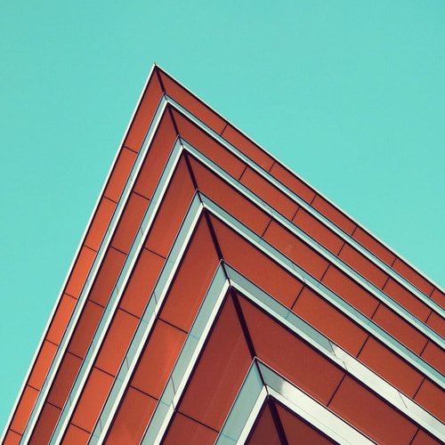
Nicholas Gooden - Composition
Artist's Name takes photographs of... He/she takes his/her photos by... This photographer considers formal elements in their work by... Something I like about Artist's Name's photography style is... I could take inspiration from this photographer in my own work by...

Slide 4
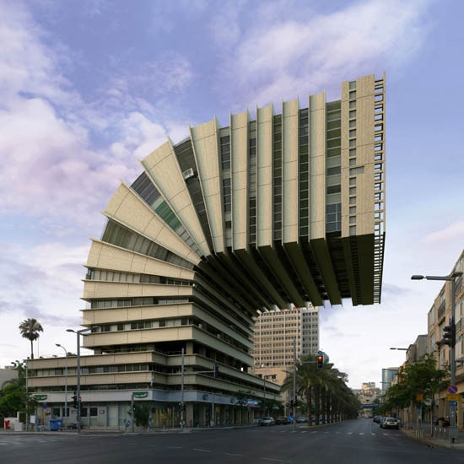
Victor Enrich – Experimental Editing
Artist's Name takes photographs of... He/she takes his/her photos by... This photographer considers formal elements in their work by... Something I like about Artist's Name's photography style is... I could take inspiration from this photographer in my own work by...

