Slide 1
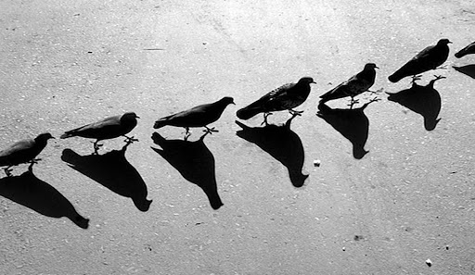
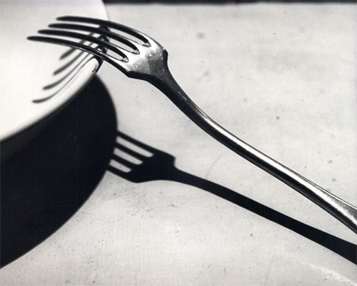
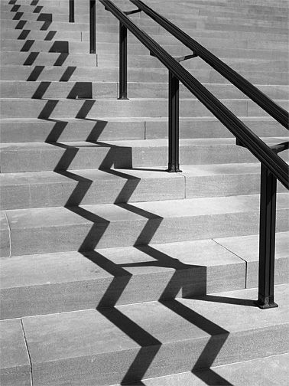
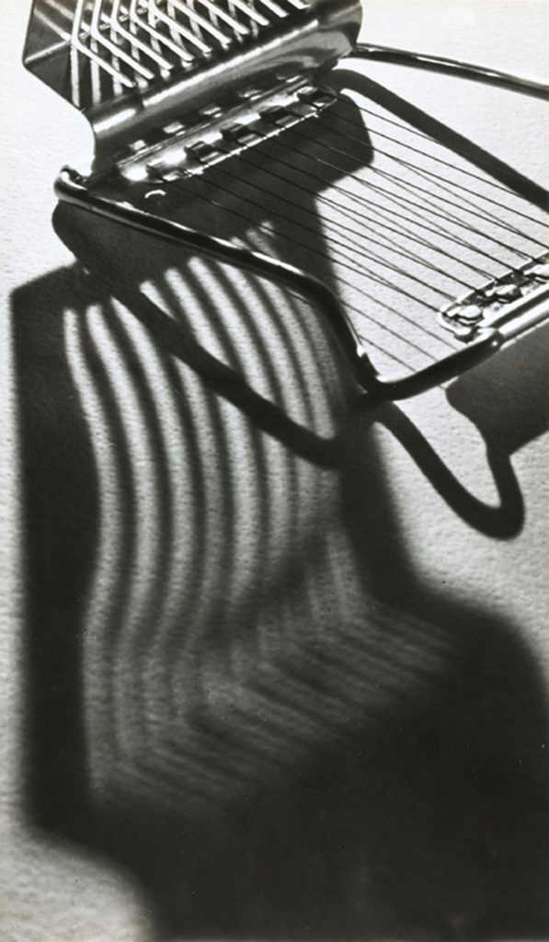
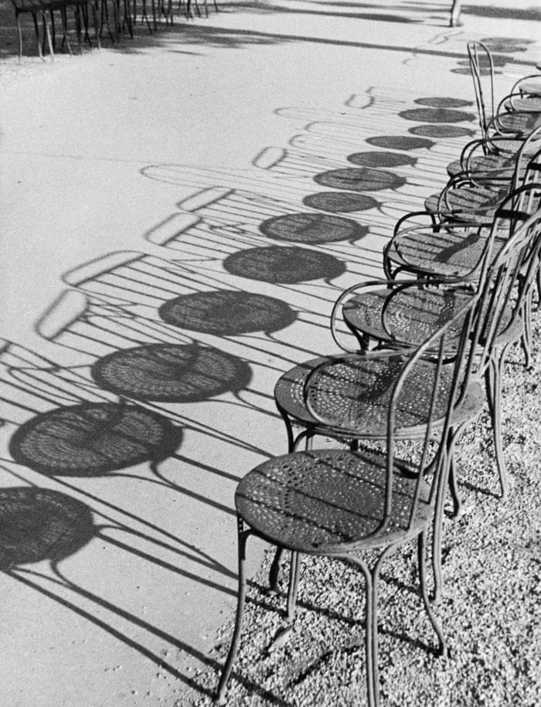
Andre Kertesz
Use the sentence starters to write a paragraph about Kertesz’s photography and his use of shadows to create patterns. DELETE THIS BOX WHEN FINISHED.
Andre Kertesz’s photography features…
His use of shadows creates…
The photo that interests me most is… because…
I could work in the style of Kertesz by…
Something else I could try is...

