Slide 1
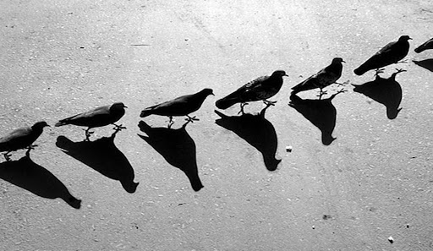
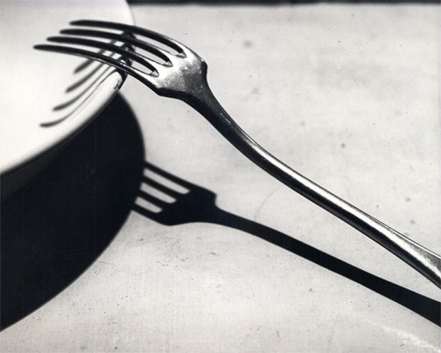
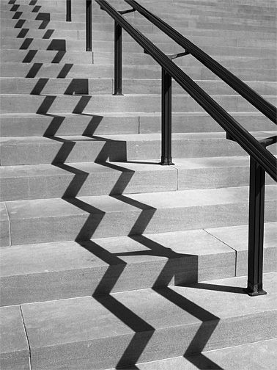
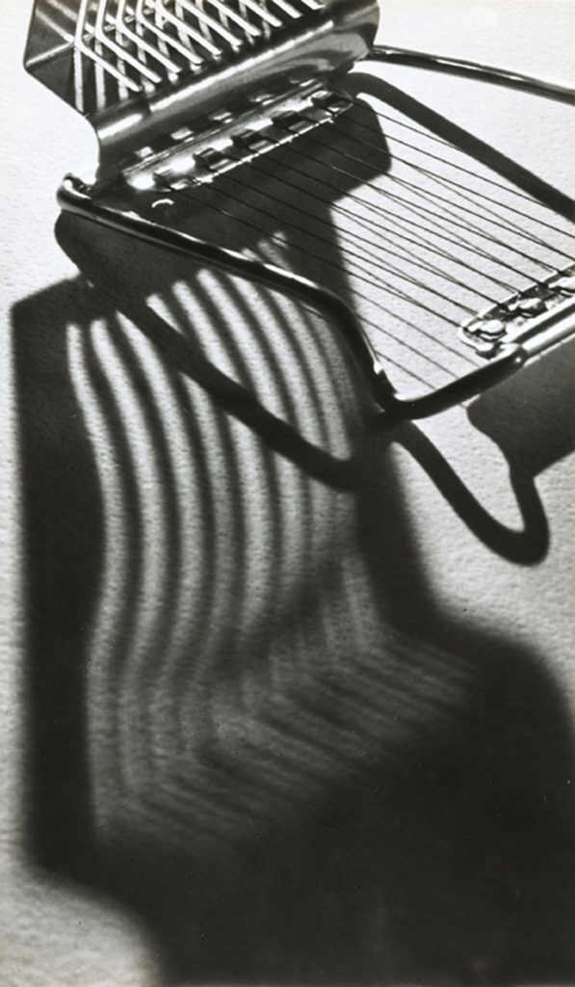
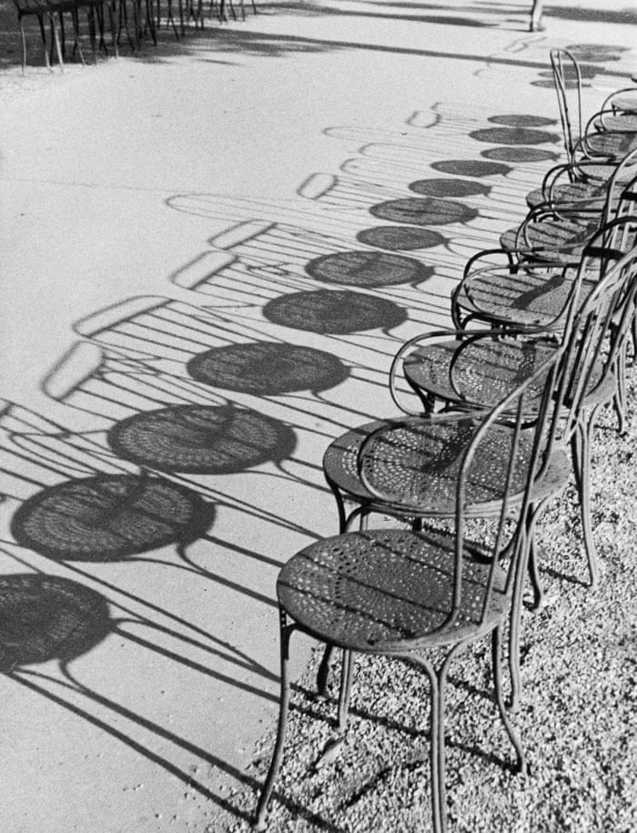
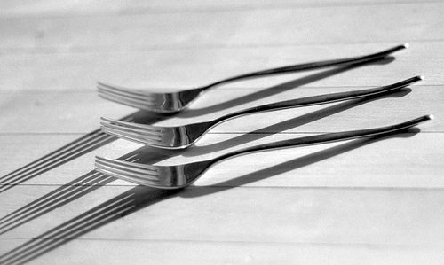
Andre Kertesz
Write a paragraph about these photographs as a whole. Describe the way he uses shadows and patterns. Analyse them. What makes them effective? Which do you like best – what do you like about it? How could you take inspiration from Kertesz’s style? DELETE THIS BOX WHEN FINISHED.

