Slide 1
Understanding the GCSE Marking Criteria
Learn about the way you are assessed in order to get the best possible marks! If you know what you are marked on, you are more likely to know how to improve your marks.

Slide 2
All of the blue slides have a task on that you need to complete.
Save your work as you go along!

Slide 3
These are the Assessment objectives for photography. What do you think they mean? Make notes of what you think next to each one.
•• AO1: Develop ideas through investigations, demonstrating critical understanding of sources.
•• AO2: Refine work by exploring ideas, selecting and experimenting with appropriate media, materials, techniques and processes.
•• AO3: Record ideas, observations and insights relevant to intentions as work progresses.
•• AO4: Present a personal and meaningful response that realises intentions and demonstrates understanding of visual language.

Slide 4
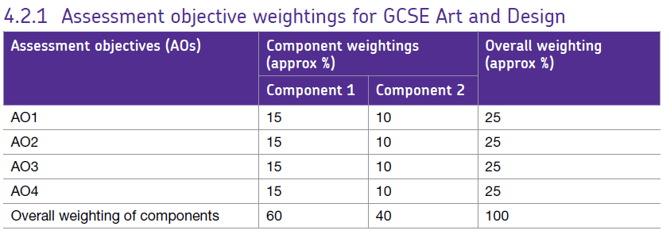
The make up of your course:
Component 1 is two coursework projects. The Human Figure and one other. This is 60% of your grade.
Component 2 is an exam project. You will choose a title from 7 choices, then develop the project independently in lessons, with 10 hour exam at the end where you will produce a final set of edited outcomes and evaluation. All work has to be handed in on the first day of your exam, and you cannot add to the project after the exam has finished. This is 40% of your grade.

Slide 5
These are the marking criteria grids. You will receive a mark out of 24 for each of the 4 assessment objectives. How well you address each one through your project will decide the mark you receive. You will then receive a total mark out of 96. What do you notice about the language differences between each mark?

Slide 7
Key language in the marking criteria:
Exceptional Ability – 8/9
Highly Developed Ability – 6/7
Consistent Ability - 5/6
Moderate Ability – 4/5
To achieve these marks you would need to be in that band in all 4 assessment objectives.

Slide 8
Put these 3 pictures in order of quality. What grades would you give them? 3= D... 4= low C... 5= high C/low B... 6 = solid B... 7= A... 8=A*... 9=A**
Answer:
Answer:
Answer:

Slide 9
AO1: Artists
The previous pieces were inspired by this photographer.
Would you say they have developed their ideas in an individual way?

Slide 10
AO1: Artists
To do well with AO1 you need to link to more than one artist and clearly use them to develop your ideas. They should be visible in all aspects of your work but in different ways. Eg.
Lighting from artist 1, background artist 2
Technique artist 1, composition artist 2
Editing style artist 1, photo style artist 2 etc.
More artists does not necessarily mean more marks, but it can mean more ideas if you use them properly. 2/3 artists is probably right for a grade 4-6. If you are aiming higher, then possibly 4 artists, if you can confidently bring together elements of all of them in your work effectively.

Slide 11
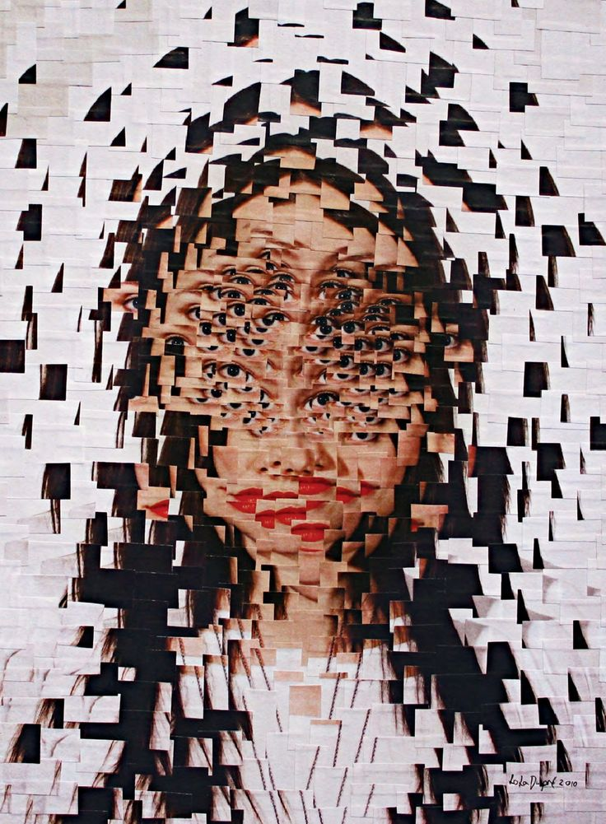
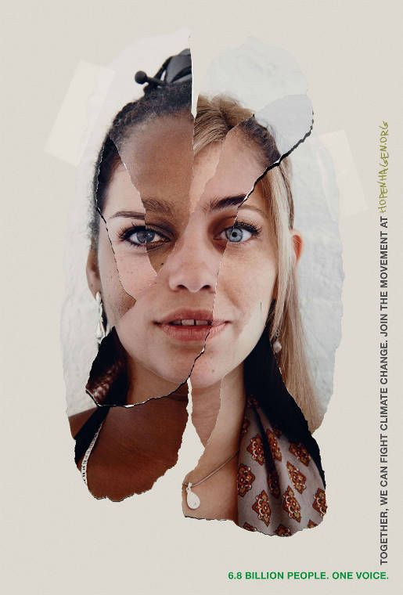
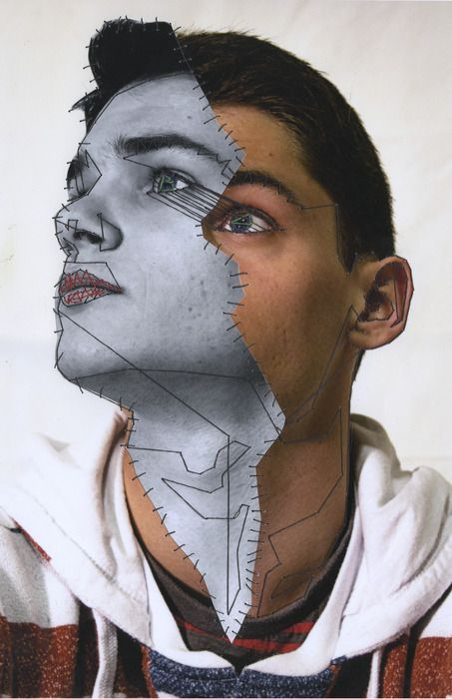
AO1: Artists
Going back to these 3 students, how could they develop their ideas inspired by 1 or more of these new artists? Write as many experiments that they could try as you can think of.
1
2
Experiments
…
3
4

Slide 12
What will you aim to do in your own project in order to get the higher marks with artist links in AO1?

Slide 13
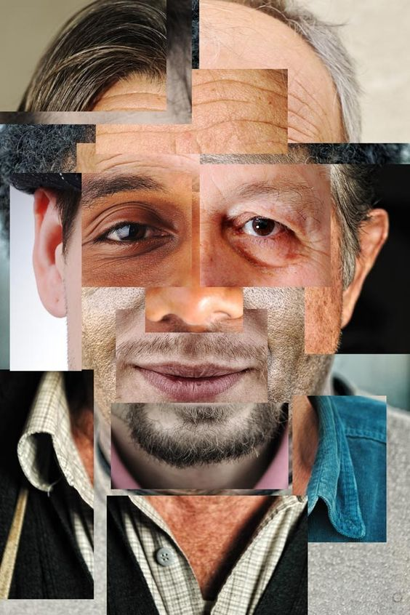
AO2: Experiments
To get the higher marks in your photography experiments you need to:
Use a range of camera techniques
Use a range of photoshop techniques
Explore a range of compositions
Photograph different subjects (the thing in your photos)
Photograph in different locations
Take LOTS of photoshoots
Try different lighting in photoshoots
Review, refine and develop
Move ideas forward as a result of each experiment

Slide 14
What do you notice about the way this student develops their project through experiments?

Slide 15
AO2: Top tips for top experiments!
Regularly reflect on what the strengths and weaknesses of your experiments are. Are you showing a wide range of skills and producing outcomes of a sophisticated, professional standard? That is what you are aiming for if you want a 6 or above. Do your experiments read like a book from top to bottom on your website, from beginning to end? Are your ideas clear? It should be clear to anyone looking at your work how your ideas have developed. How has each experiment led onto the next? How have you reflected on your experiments in order to move forwards and improve? How have your artists and photographers inspired your ideas? Have you carried out a wide range of photo shoots in different locations and of different things linked to your ideas? Are they inspired by your photographers? Are your photographs skillfully taken? Do you use the formal elements to help you take effective photographs and talk about them in your annotations?

Slide 16
AO2: Top tips for top experiments!
Have you really experimented with lighting, atmosphere, mood composition? These are some of the most effective ways of getting great photos!
Have you photographed lots of different things? Eg. If you are photographing people, have you photographed the same person over and over or have you shown variety?
Have you shown lots of different skills when editing your photographs? Have you edited purposefully in order to enhance your idea and concept? Have you avoided being repetitive to make sure that your ideas are developing forwards rather than just staying still? Have you taken inspiration from a range of carefully chosen photographers? Can you explain why you chose those photographers fluently using technical language? Have your ideas developed effectively as a result of different photoshoots and experiments? Have they moved forwards rather than just stuck with the same idea that you had at the start of the project? Are your final piece ideas exciting? Do they bring together all of your experiments? Is your final piece the best experiment? It should be! Does it showcase the best of your skills?

Slide 17
What will you aim to do in your own project in order to get the higher marks in your experiments for AO2?

Slide 18
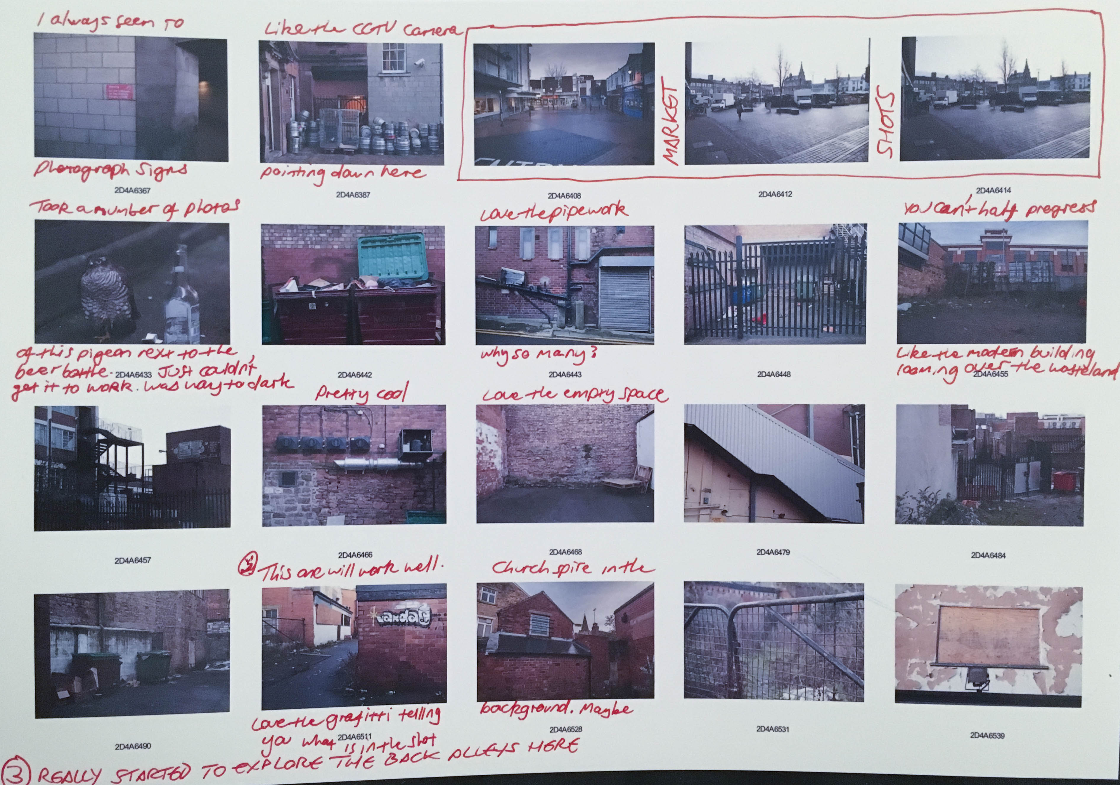
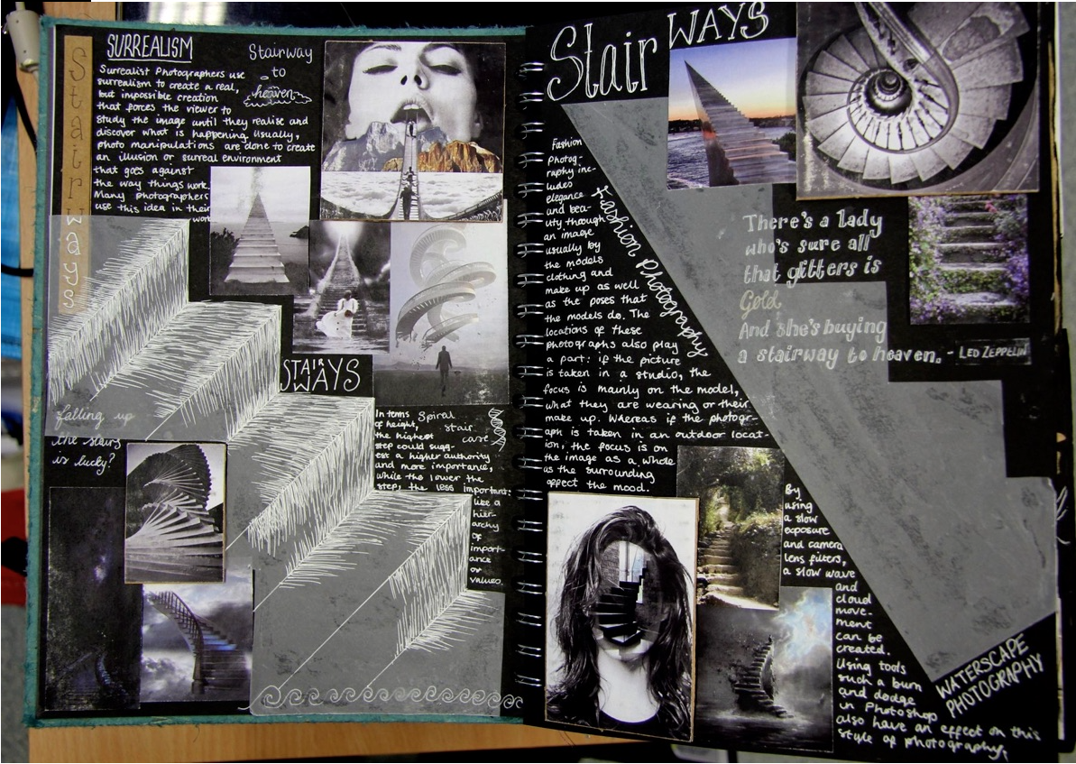
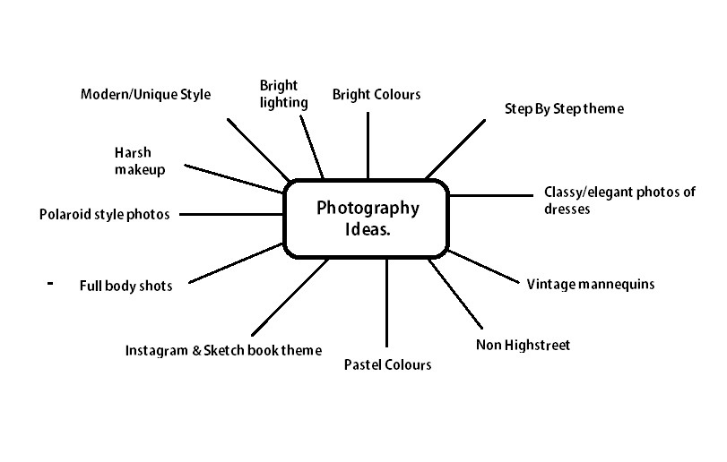
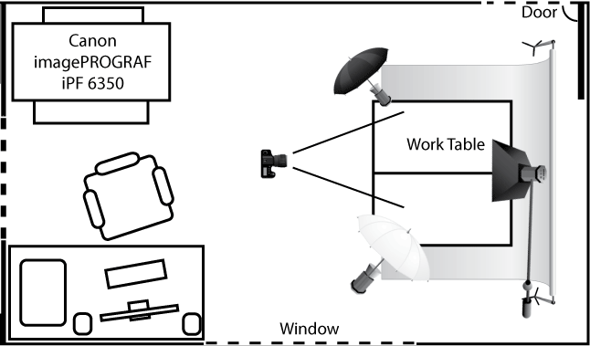
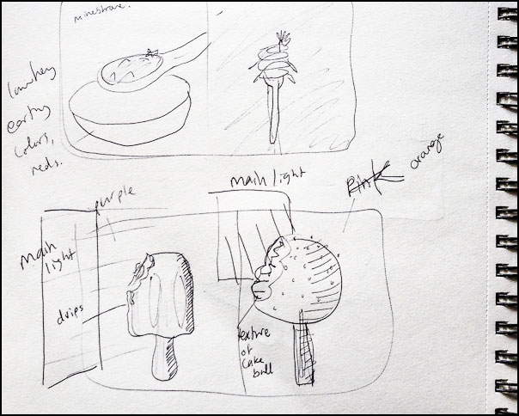
AO3: Recording ideas
Mind maps
Photo shoots
Contact sheets
Drawings
Photoshoot plans
Evaluations and notes

Slide 19
AO3: Recording your ideas what do you think will help you to get higher marks for each of these options in AO3?
Mind maps
Taking photos
Drawing
Notes on ideas
Photoshoot Plans
Evaluations

Slide 20
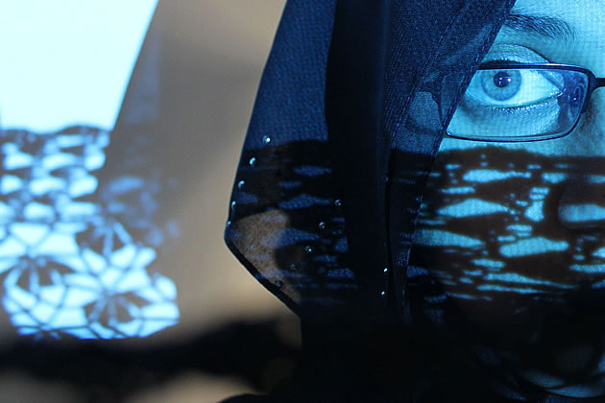
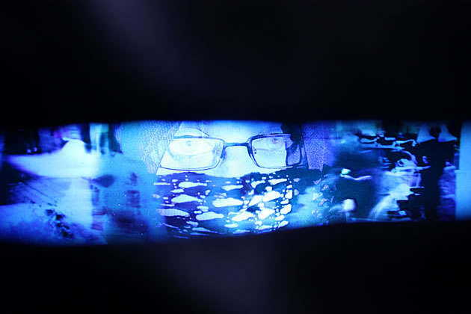
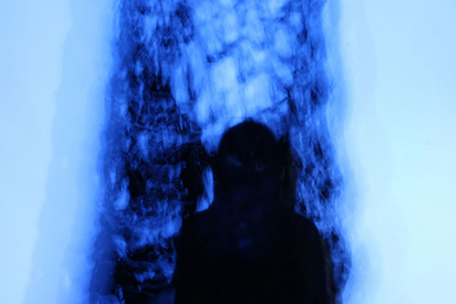
AO4: Present a personal and meaningful response that realises intentions and demonstrates understanding of visual language.
Look at this student’s A Grade A-level project http://www.studentartguide.com/featured/a-level-photography-identity
You can achieve marks for AO4 at any stage of your project, it is not just the final piece. It is anywhere that the student brings there ideas together effectively, such as these 3 examples.

Slide 21
Watch this video of the sketchbook to go with this student’s project.
https://youtu.be/RCvR5We977c
If video doesn’t work, use this link.

Slide 22
AO4: Realising intentions
If ‘realising intentions’ means achieving what you set out to do, how well has this student realised intentions in her project and how do you know? Bullet point answers are fine.

